Slide 1

ALZHEIMER SYNDROME
RECOGNITION
TEAM MEMBERS GUIDED BY
KIRTHICK SAKTHI V (21CS046) Mrs. S. SUJITHA AP/CSE
MANIKANDAN L (21CS055)
MANOJKUMAR K (21CS056)

Slide 2
OBJECTIVE
To understand risk factors need to collect data on genetics, lifestyle and health history.
To develop tools that can predict who might be at higher risk. With these predictions, able to identify individuals symptoms before appear.
To start early interventions, such as treatments or lifestyle changes, to help delay or prevent the disease and improve quality of life.

Slide 3
ABSTRACT
Alzheimer's syndrome is classified using a deep learning-based leverages MRI brain images. By utilizing a pre-trained ResNet model, it classifies brain scans into four categories: Non-Demented, Very Mild Demented, Mild Demented, and Moderate Demented.
Convolutional Neural Networks (CNNs) play a crucial role in Alzheimer's Syndrome(AS) diagnosis through MRI scan analysis. Afterward, the model predicts the likelihood of Alzheimer's progression across the four classification categories.

Slide 4
LITERATURE SURVEY
Paper Title | Author | Journal Name | Year | Key Points
Alzheimer’s Disease and Mild Cognitive Impairment Detection Using MRI With Efficient Receptive Field and Enhanced Multi-Axis Attention Fusion. | UTTAM KHATRI | IEEE Journal of Biomedical and Health Informatics. | 2024 | Detect Alzheimer's and Mild Cognitive Impairment early.
A Review on Alzheimer’s Disease Through Analysis of MRI Images Using Deep Learning Techniques | BATTULA SRINIVASA RAO | IEEE Xplore | 2024 | Detecting Alzheimer Disease early by analyzing MRI scans using deep learning.
Alzheimer's Diseases Detection by Using Deep Learning Algorithms: A Mini-Review | SUHAD AL-SHOUKRY, TAHA H. RASSEM | IEEE Transactions on Medical Imaging | 2023 | Deep learning can help identify AD at an earlier stage.
Multimodal 3D Deep Learning for Early Diagnosis of Alzheimer’s Disease | SEUNG KYU KIM | IEEE Transactions on Neural Networks and Learning Systems | 2023 | Multimodal 3D deep learning provides a faster and more accurate way to diagnose AD.

Slide 5
Paper Title | Author | Journal Name | Year | Key Points
Early Diagnosis of Alzheimer’s Disease Using 18F-FDG PET With Soften Latent Representation | ABDUL REHMAN, MYUNG-KYU Y | IEEE Journal of Medical Imaging and Health Informatics | 2023 | Helps in better feature extraction, reducing noise and enhancing model performance.
Clinical diagnosis of Alzheimer’s disease | M. Folstein | IEEE Transactions on Cognitive and Developmental Systems | 2022 | Provides a consistent framework for diagnosing AD improving accuracy across clinics.
Generalizable deep learning model for early Alzheimer’s disease detection from structural MRIs | V. Masurkar | IEEE Transactions on Neural Networks and Learning Systems | 2022 | The model aims to work across various populations and MRI settings, improving its practical applicability.
Alzheimer’s disease detection from structural mri using fusion transformer. | R. Kushol | IEEE Transactions on Medical Imaging | 2021 | Combines multiple brain regions and features for more accurate and holistic analysis.

Slide 6
EXISTING SYSTEM
Cognitive Impact: Mild cognitive impairment, with slight challenges in planning, problem-solving, or organizing tasks.
Genetic Risk: Presence of the APOE ε4 allele may increase susceptibility and accelerate progression in individuals with mild cognitive impairment.
Diagnosis: Early detection is possible through cognitive tests, brain imaging, and biomarker analysis, though symptoms might be attributed to normal aging at first.
Cognitive Engagement: Engaging in activities like puzzles, reading, and learning new skills to maintain brain health.

Slide 7
PROPOSED SYSTEM
Cognitive Decline Prediction: Algorithms that forecast cognitive decline rates from cognitive test results.
Deep Learning Models: Advanced neural networks improve accuracy in predicting Alzheimer's from large datasets.
Multi-Modal Data Integration: Combining MRI, PET scans, genetic data, and clinical tests for comprehensive analysis.
Blood Biomarker Analysis: Predicting Alzheimer's using blood tests for proteins like amyloid-beta and tau.

Slide 8
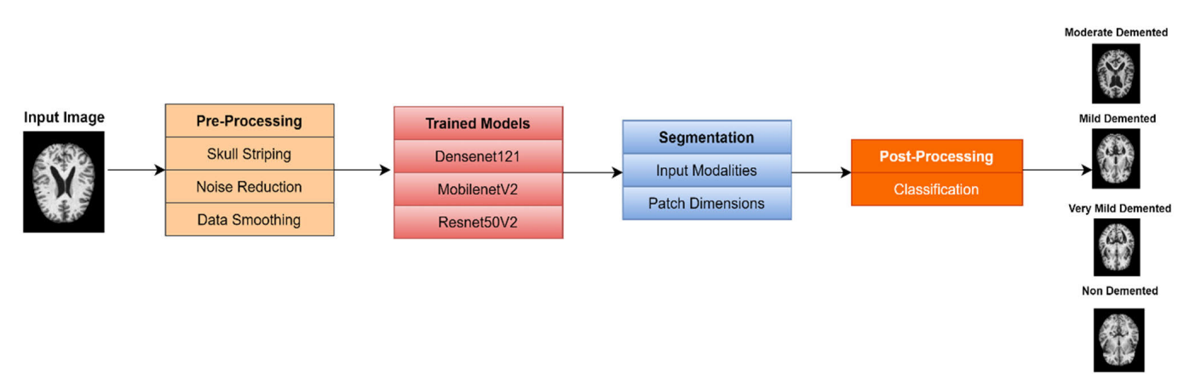
FUNCTIONAL DIAGRAM

Slide 9
MODULES DESCRIPTION
Early Detection and Diagnosis
Alzheimer's can be detected in early stages through cognitive assessments, brain imaging, and biomarker analysis. Early diagnosis allows for timely intervention to slow the syndrome's progression.
Cognitive and Behavioral Symptoms
Alzheimer's symptoms begin with mild memory loss and difficulty in finding words. As the disease progresses, patients experience confusion, personality changes, and difficulty with daily tasks.
Technological Advancements in Prediction
Deep learning models and AI are being used to predict Alzheimer's based on multimodal data like brain scans, genetic tests, and biomarkers. Early prediction aids in proactive disease management and tailored treatment plans.

Slide 10
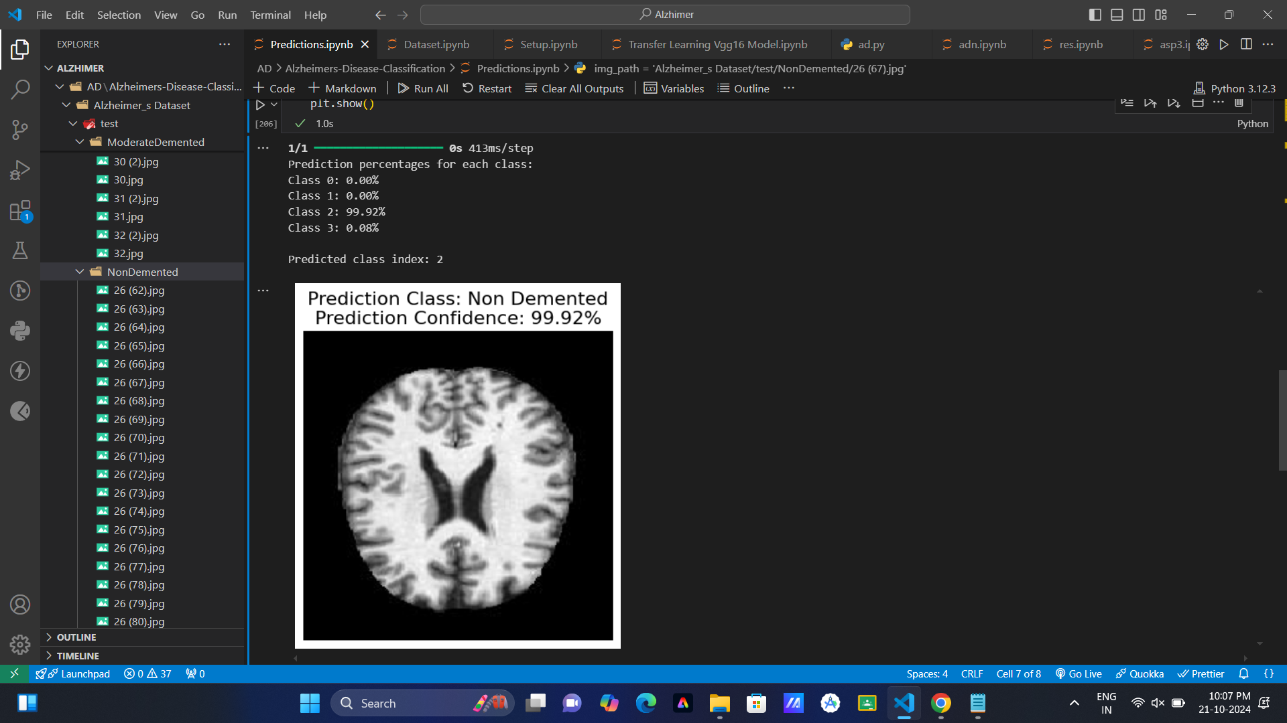
Final Outputs

Slide 11
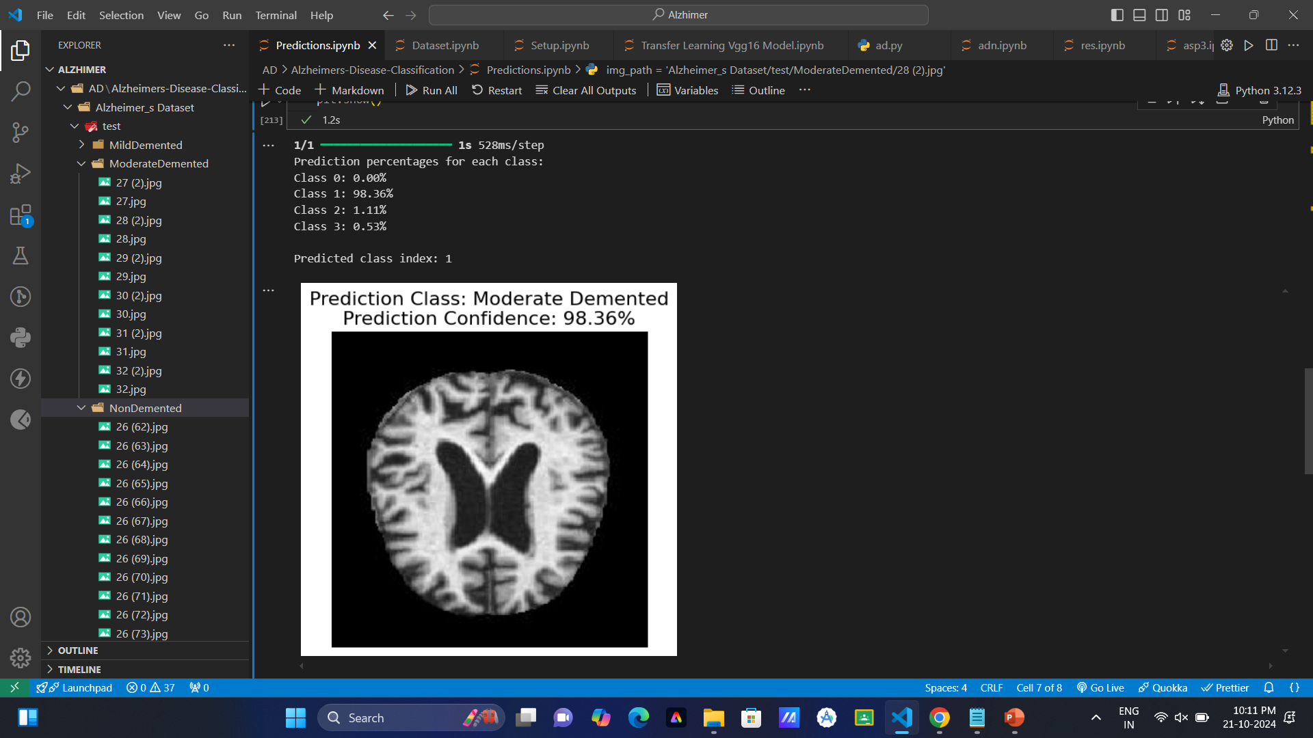

Slide 12
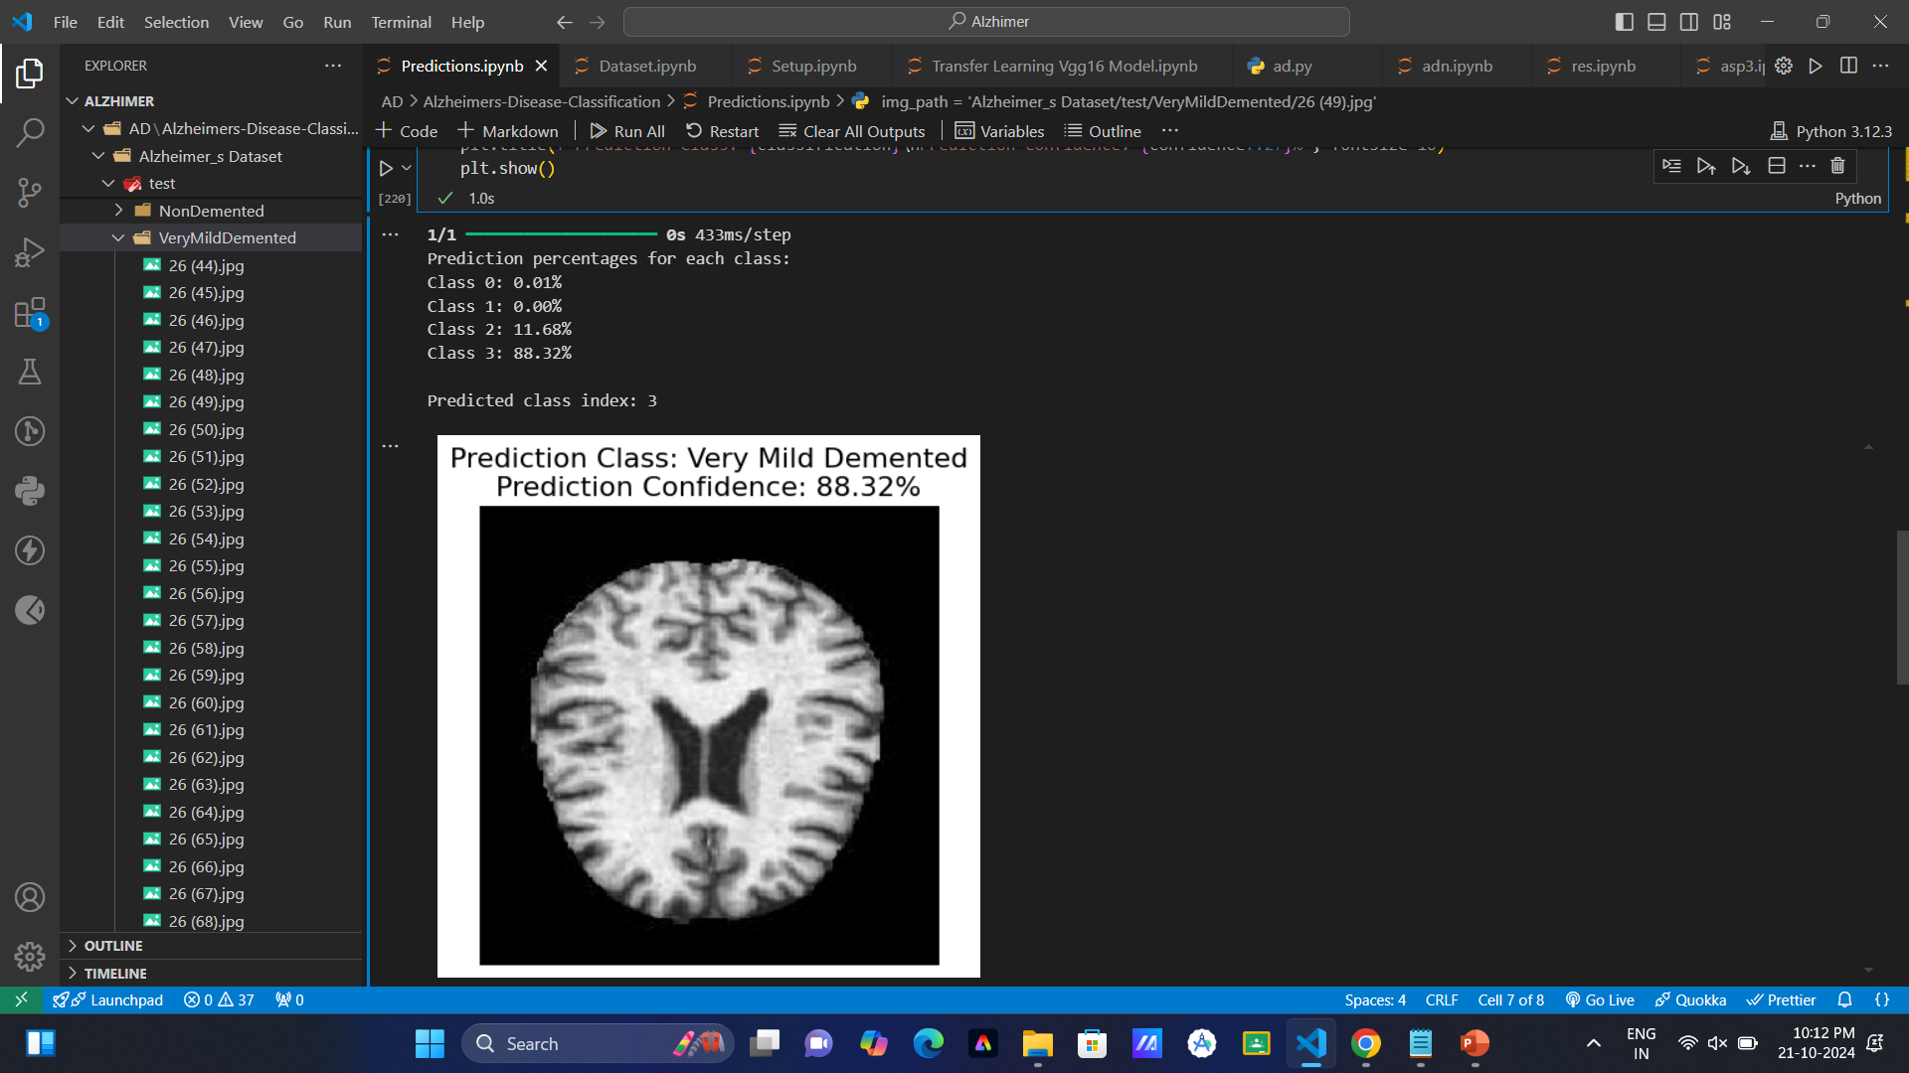

Slide 13
CONCLUSION
Alzheimer's Syndrome progresses from mild cognitive impairment to severe memory loss and dependency over three stages. Early diagnosis and intervention in the mild stage can help slow its progression. As the disease advances, comprehensive care and support become crucial for managing symptoms and ensuring patient well-being.
Highly effective model in this study that utilizes the self-attention mechanism to classify MRI data associated with Alzheimer’s disease. Segmentation of brain MRI scans helps in their interpretation and categorization for diseases like Alzheimer’s.

Slide 14
REFERENCES
Z. Huang, X. Zhu, M. Ding, and X. Zhang, ‘‘Medical image classification using a light-weighted hybrid neural network based on PCANet and DenseNet,’’ IEEE Access, vol. 8, pp. 24697–24712, 2020.
R. K. Mishra, S. Urolagin, J. A. A. Jothi, A. S. Neogi, and N. Nawaz, ‘‘Deep learning-based sentiment analysis and topic modeling on tourism during COVID-19 pandemic,’’ Frontiers Comput. Sci., vol. 3, pp. 1–10, Nov. 2021.
Z. Pei, Y. Gou, M. Ma, M. Guo, C. Leng, Y. Chen, and J. Li, ‘‘Alzheimer’s disease diagnosis based on long-range dependency mechanism using convolutional neural network,’’ Multimedia Tools Appl., vol. 81, no. 25, pp. 36053–36068, Oct. 2022.
R. Gautam and M. Sharma, ‘‘Prevalence and diagnosis of neurological disorders using different deep learning techniques: A meta-analysis,’’ J. Med. Syst., vol. 44, no. 2, pp. 1–24, Feb. 2020.
M. Aparna and B. Srinivasa Rao, ‘‘Xception-FractalNet: Hybrid deep learning based multi-class classification of Alzheimer’s disease,’’ Comput., Mater. Continua, vol. 74, no. 3, pp. 6909–6932, 2023.
S. M. Anwar, M. Majid, A. Qayyum, M. Awais, M. Alnowami, and M. K. Khan, ‘‘Medical image analysis using convolutional neural networks: A review,’’ J. Med. Syst., vol. 42, no. 11, p. 226, Oct. 2018.

Slide 15
R. Azad, A. Kazerouni, M. Heidari, E. Khodapanah Aghdam, A. Molaei, Y. Jia, A. Jose, R. Roy, and D. Merhof, ‘‘Advances in medical image analysis with vision transformers: A comprehensive review,’’ 2023, arXiv:2301.03505.
K. Han, Y. Wang, H. Chen, X. Chen, J. Guo, Z. Liu, Y. Tang, A. Xiao, C. Xu, Y. Xu, Z. Yang, Y. Zhang, and D. Tao, ‘‘A survey on vision transformer,’’ IEEE Trans. Pattern Anal. Mach. Intell., vol. 45, no. 1, pp. 87–110, Jan. 2023, doi: 10.1109/TPAMI.2022.3152247.
M. Raghu, T. Unterthiner, S. Kornblith, C. Zhang, and A. Dosovitskiy, ‘‘Do vision transformers see like convolutional neural networks?’’ 2021, arXiv:2108.08810.
G. Hcini, I. Jdey, and H. Dhahri, ‘‘Investigating deep learning for early detection and decision-making in Alzheimer’s disease: A comprehensive review,’’ Neural Process. Lett., vol. 56, no. 3, p. 153, Apr. 2024, doi: 10.1007/s11063-024-11600-5.
G. M. Hoang, U.-H. Kim, and J. G. Kim, ‘‘Vision transformers for the prediction of mild cognitive impairment to Alzheimer’s disease progression using mid-sagittal sMRI,’’ Frontiers Aging Neurosci., vol. 15, Apr. 2023, Art. no. 1102869.
H. Shin, S. Jeon, Y. Seol, S. Kim, and D. Kang, ‘‘Vision transformer approach for classification of Alzheimer’s disease using 18F-florbetaben brain images,’’ Appl. Sci., vol. 13, no. 6, p. 3453, Mar. 2023, doi: 10.3390/app13063453.

Slide 16
THANK YOU!...

